Slide 1


FlyNet: Autonomous Quadcopter Search and Rescue

Slide 2
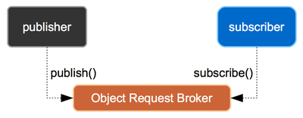
Pixhawk Application Framework
FlyNet: Autonomous Quadcopter Search and Rescue

Slide 3
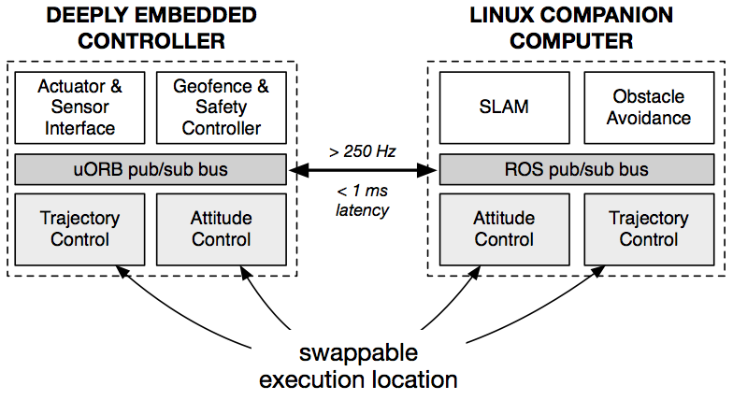
High Level Architecture
FlyNet: Autonomous Quadcopter Search and Rescue

Slide 4
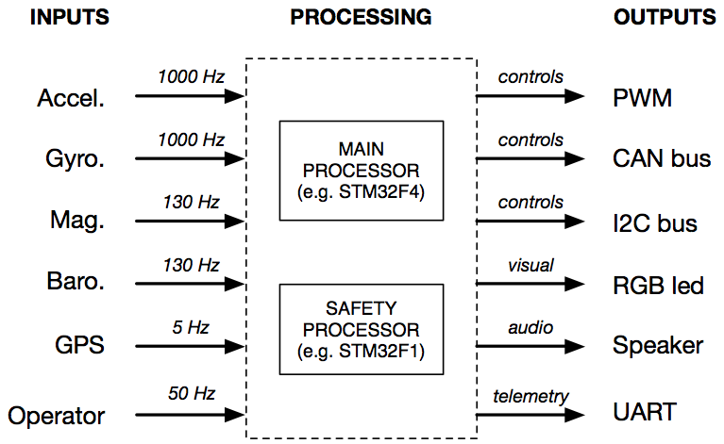
Sensors
FlyNet: Autonomous Quadcopter Search and Rescue

